Slide 1



Titolo presentazione sottotitolo
POLITECNICO
DI MILANO
Hackaton Pitch
Milano, XX mese 20XX
Creative Programming and Computing Course

Slide 2

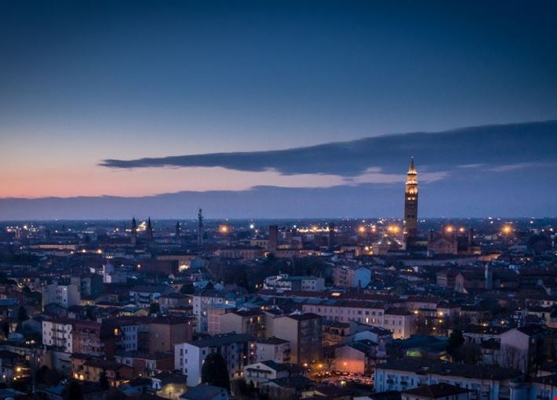
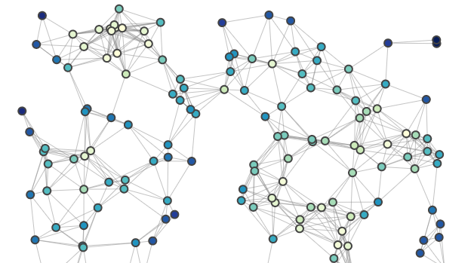
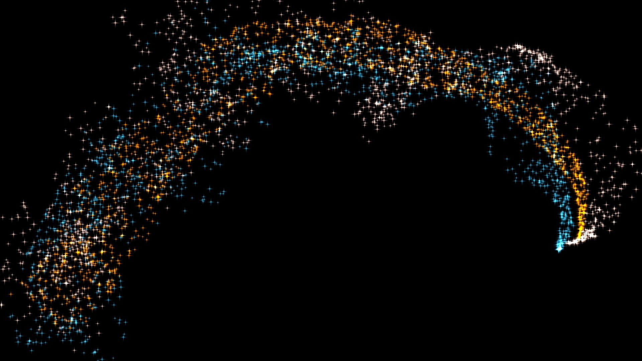
City Map Landscape
Citizens’ interaction with city spaces
City modifies citizens behaviour

Slide 3
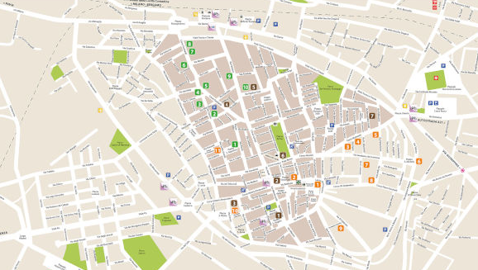
City Map SoundScape
Focus on a node
Data about the node
Audio Generation

